Slide 1
ROCO218: Control Engineering Dr Ian Howard Lecture 2 Modelling electrical circuits with differential equations

Slide 2
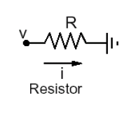
Electrical resistance
Resists the flow of current
Where
i is the current in A
v is voltage in V
R is the resistance in Ω

Slide 3
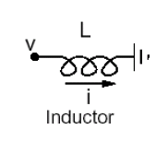
Electrical inductance
Where
i is the current in A
v is voltage in V
L is the inductance in H

Slide 4
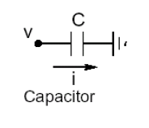
Electrical capacitance
Therefore
Where
i is the current in A
v is voltage in V
C is the capacitance in F
Also
Where Q is charge

Slide 5
A First-order RC Circuit
v_{r}(t)
+
–
R
+
+
–
v_{s}(t)
C
v_{c}(t)
–
One capacitor and one resistor in series
The source and resistor may be equivalent to a circuit with many resistors and sources

Slide 6
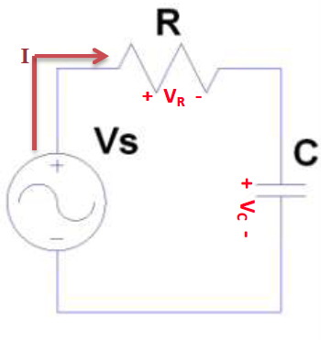
Voltages in an RC circuit
Adding up voltages
Ohms law
Current proportional to
rate of change of charge
Substitute I from
capacitor expression
Rearranged
This is a first order linear differential equation

Slide 7
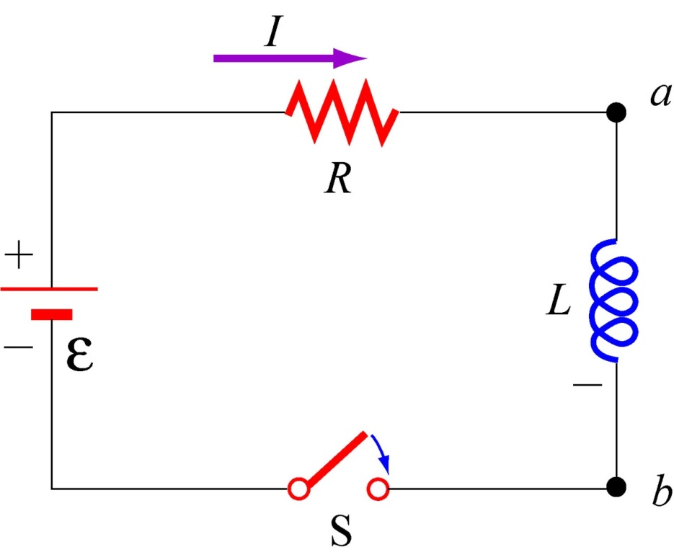
Current in an LR circuit
Adding up voltages
Ohms law
Voltage proportional to
rate of change of current
Substituted values
Rearranged
This is also a first order linear differential equation

Slide 8
2nd order LCR circuits
Any circuit with a single capacitor, a single inductor, an arbitrary number of sources, and an arbitrary number of resistors is a circuit of order 2
The source and resistor may be equivalent to a circuit with many resistors and sources
Any voltage or current in such a circuit is the solution to a 2nd order differential equation
i (t)
R
+
–
v_{s}(t)
C
L

Slide 9
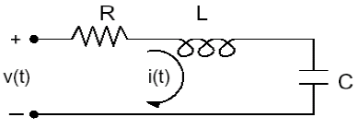
Series RLC circuit
Adding up the contributions to overall applied voltage

Slide 10
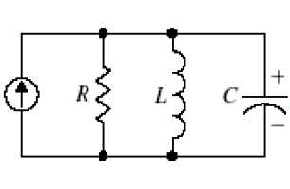
Parallel RLC circuit
Adding up the contributions to overall applied current

Slide 11
Summary: RLC Characteristics
Element | V/I Relation | Comments
Resistor |  | V = I R R has SI unit Ohms
Capacitor |  | Q = CV C has SI unit is Farads
Inductor |  | L has SI unit Henrys

Slide 12
ROCO218: Control Engineering Dr Ian Howard Lecture 2 Modelling mechanical systems using differential equations

Slide 13
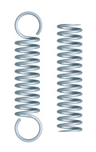
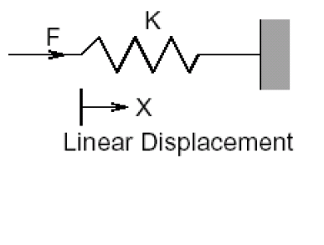
Compression & extension springs
Resists with opposing force proportional to extension of movement
where
f is force in N
k is the spring constant in N/m

Slide 14
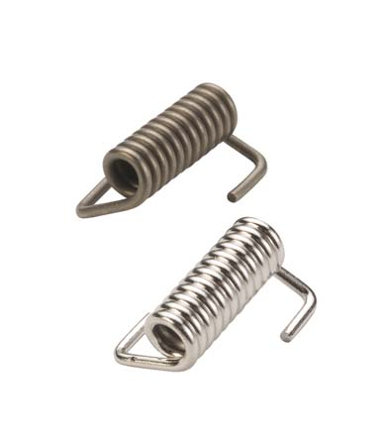
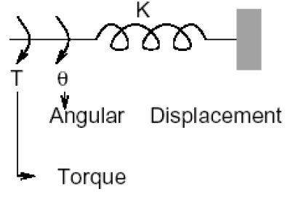
Torsional springs
where
T is torque in Nm
k is the spring constant in Nm/rad

Slide 15
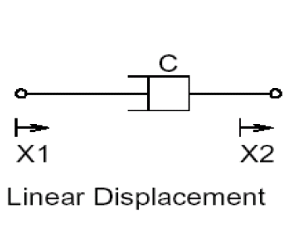
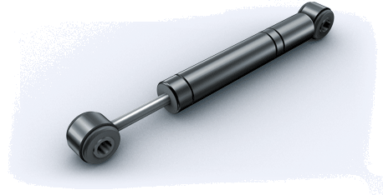
Dampers and dashpots
Resists with opposing force proportional to velocity of movement
Like moving your hand in water – resistance proportional to how fast you move
Dampers/ shock absorber
Where
f is force in N
C is viscosity in Ns/m

Slide 16
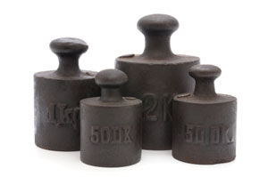
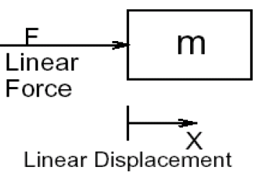
Inertial Mass
Resists with opposing force proportional to acceleration of movement
Where
f is force in N
m is mass in Kg
a is linear acceleration in m/s²

Slide 17
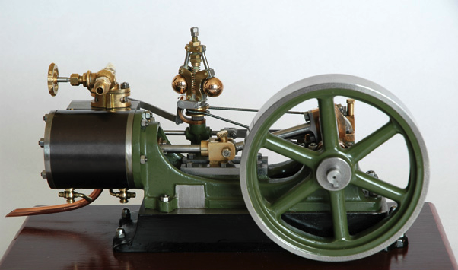
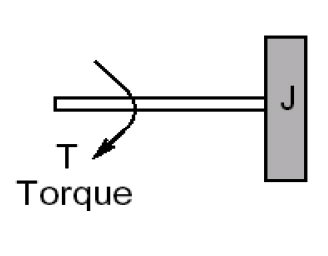
Moment of Inertia
Resists with opposing torque proportional to angular acceleration
Where
T is torque in Nm
J is moment of inertial in Kgm²

Slide 18
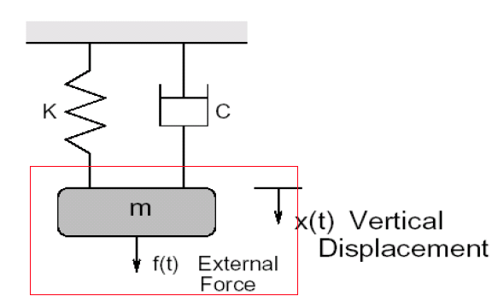
Spring mass damper system
Adding up the contributions to overall force

Slide 19
ROCO218: Control Engineering Dr Ian Howard Lecture 2 Circular movement

Slide 20
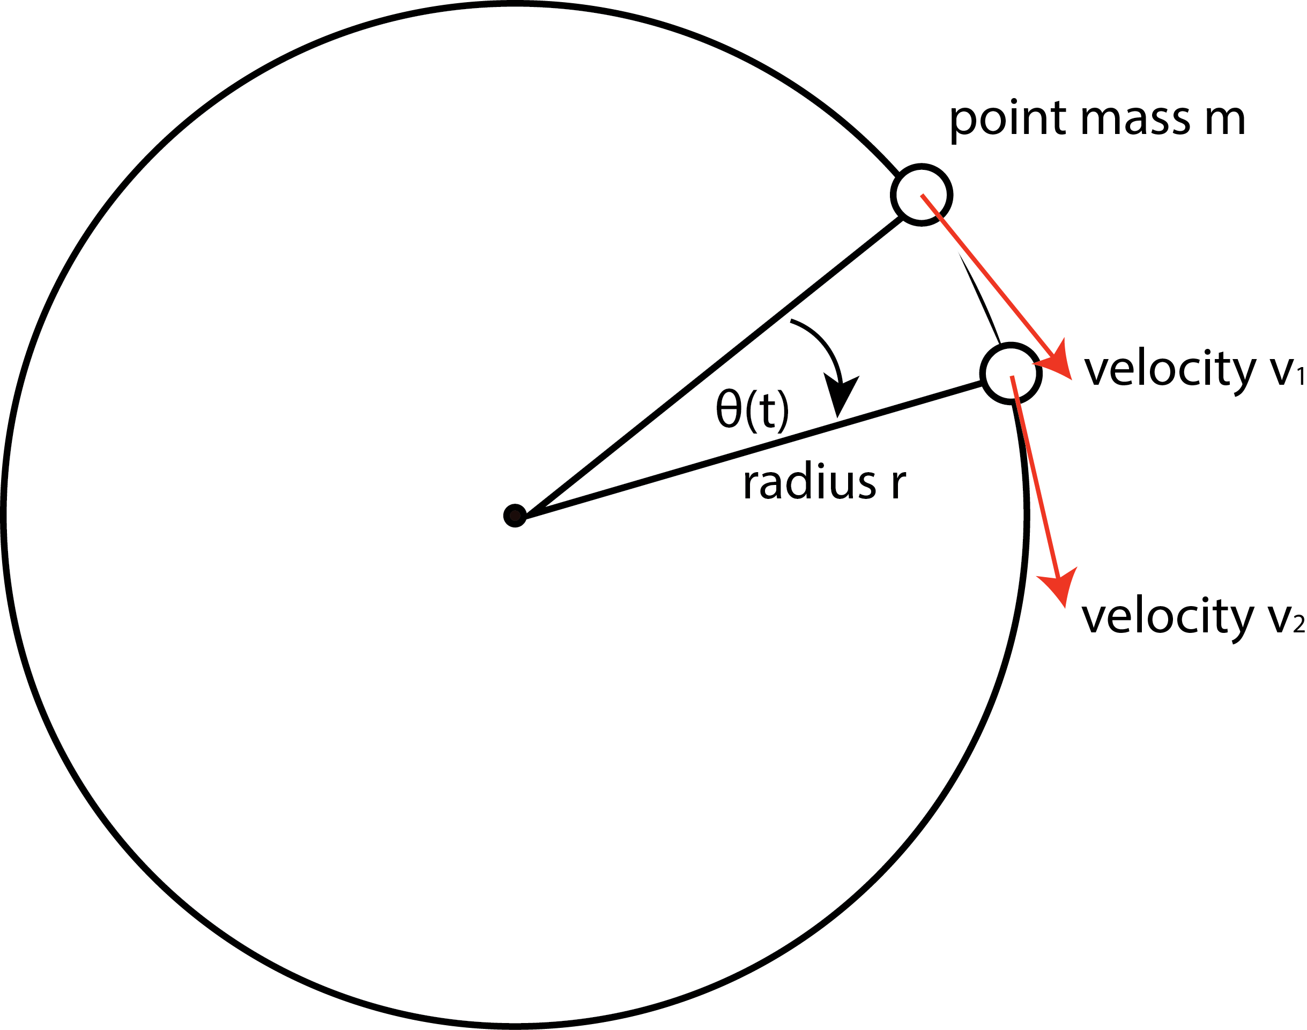
Constant speed circular movement
Consider a point mass travelling around central point in a circle at a constant speed with rotational period
Therefore in T seconds is rotates though an angle of 2π radians
Thus angular velocity ω is given by
The distance travelled by the mass in time T seconds is given by
The average speed at which is does so it therefore
Note also
The rotational frequency can be related to rotational period T
Substituting in

Slide 21
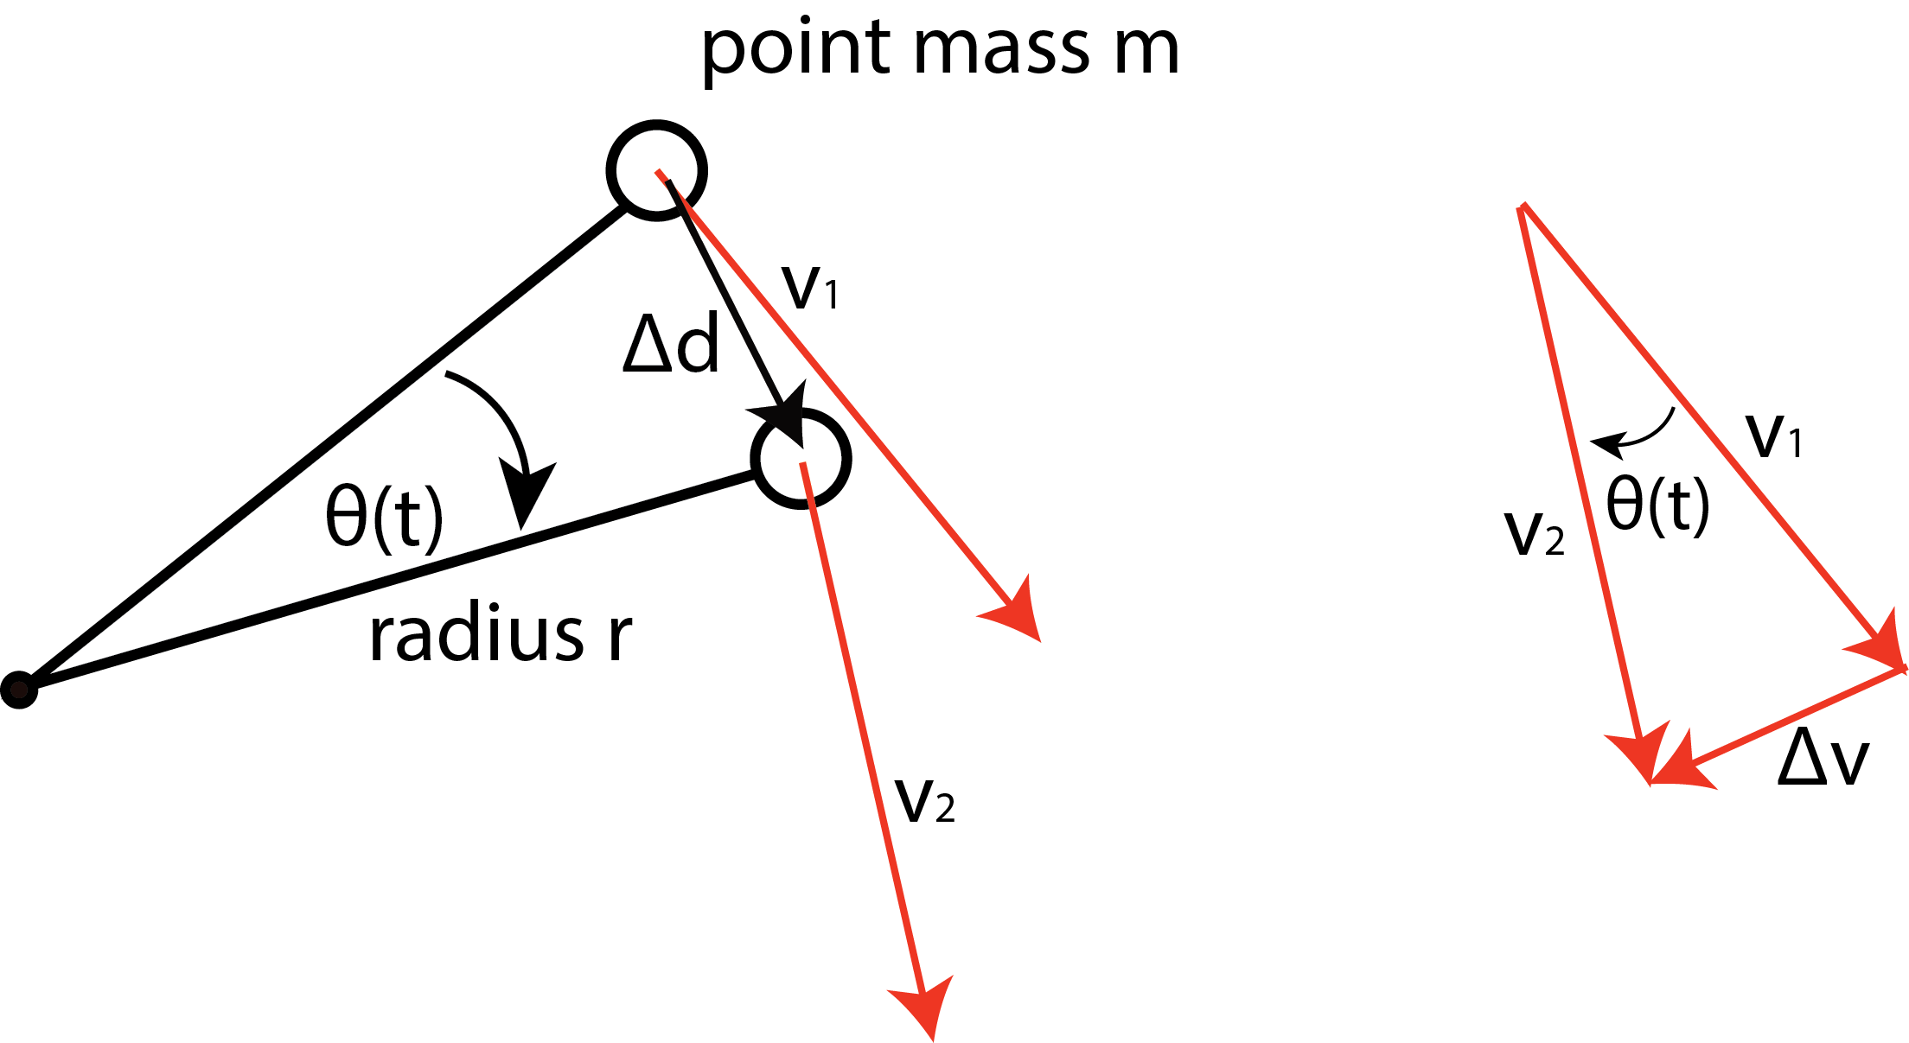
Simple derivation of centrifugal acceleration
Consider the moving mass
As the mass rotates through an angle of θ the tangential velocity of the mass changes from v₁ to v₂
Mass moves a distance Δd
Velocity magnitude stays constant but its direction changes so velocity changes by Δv
By consideration of similar triangles with the same angle θ
if Δd is very very small is can be approximated by
Substituting in this value
As Δt tends to 0, term Δv/Δt represents acceleration
Since from before

Slide 22
Chain rule for single variable differentiation
Consider the one variable equation corresponding to a function of a function
For example if
In this case let
Writing
Chain rule gives

Slide 23
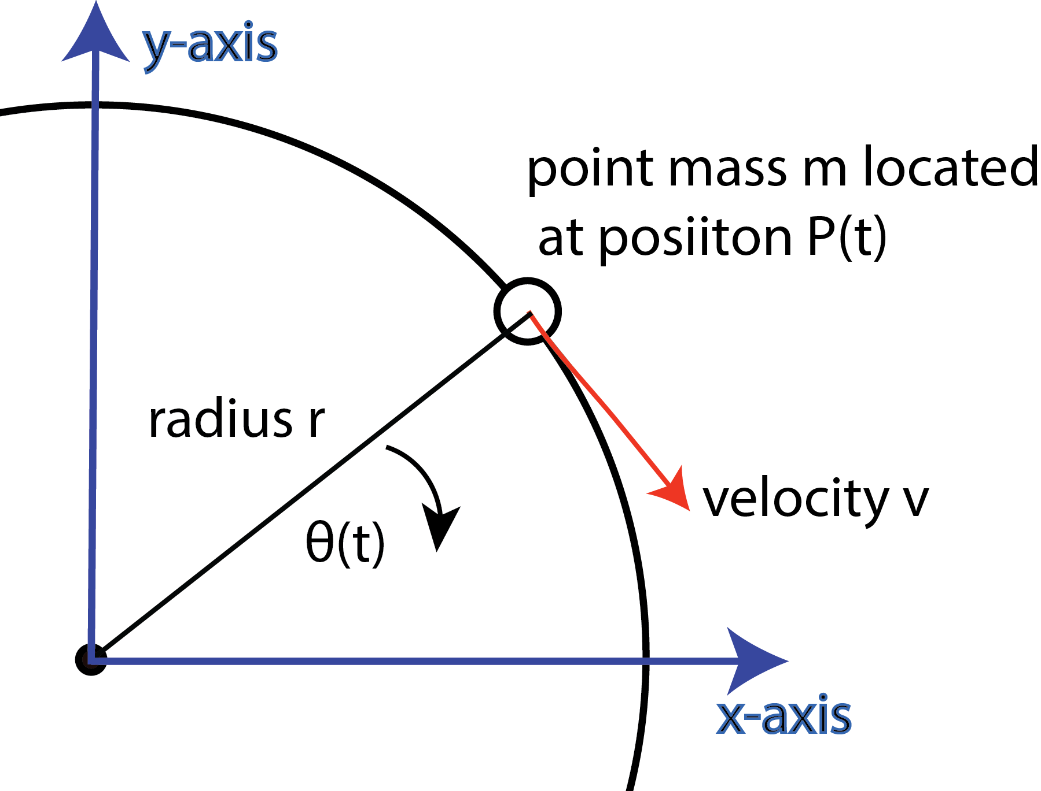
Calculus derivation of centrifugal acceleration
We can write down the projections of the mass position along the x and y axes
We can write mass position vector P(t) as sum of its base vector components
Differentiating both sides wrt time t gives

Slide 24
Calculus derivation of centrifugal acceleration
Now angular velocity is given by
Which is a constant if speed is constant. Substituting into
Differentiating the expression again

Slide 25
Calculus derivation of centrifugal acceleration
Now acceleration A(t) is given by
Taking the modulus of both sides
Note that
Is just the radius of the circle
Or as from before

Slide 26
ROCO218: Control Engineering Dr Ian Howard Lecture 2 Modelling a DC motor

Slide 27
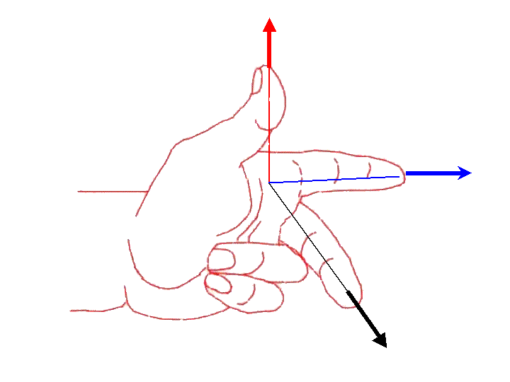
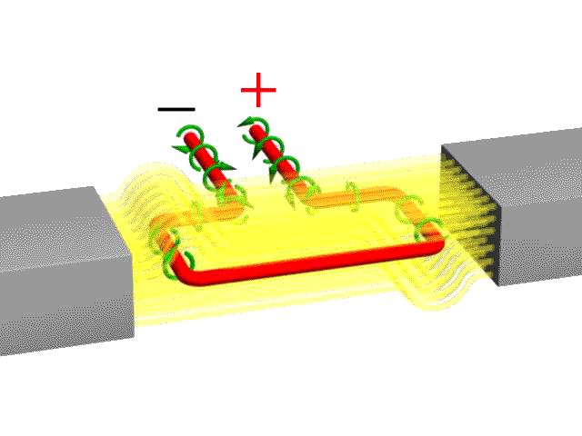
Fleming's Left Hand (Motor) Rule
The Left Hand Rule to determines the movement direction of conductor carrying current
Thumb = Direction of Conductor Motion
Fore Finger = Direction of Magnetic
Left Hand
Middle Finger = Conventional Current Direction
S
N

Slide 28

Motor Torque constant K_{t}
current direction towards brush
forces:
force on current leading conductor in a magnetic field
force
torque:
sum of all forces at the distance to the rotating axis
influencing parameters:
geometry
field density
winding number
Depend on the design
magnetic
field
force
Motor torque T_{m} is given by
current direction towards flange
Notes:
This schematic motor cross section shows the origin of the simple proportional relationship between torque and current. The underlying physical principle is the force on a current conducting wire in an external magnetic field.
The amount of torque produced depends on the geometrical arrangement of the winding, its distance to the rotation axis, the density of winding turns, the strength of the magnetic field in the air gap and the amount of current applied. With the exception of the current all the other parameters are defined by the intrinsic design and cannot be changed on the finished motor. That's why they are summed up in one constant, the torque constant k_{M}. The amount of torque produced by the motor becomes proportional to the motor current.

Slide 29
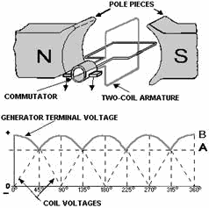
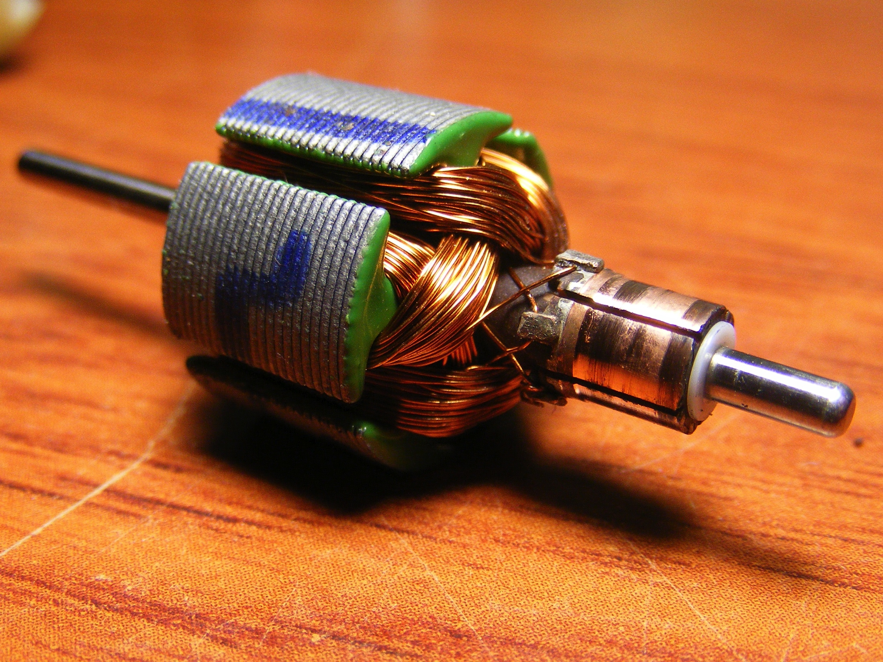
Multiple coils reduces torque ripple
Overall torque summed from both coils
Typical small armature
with multiple multi-turn coils

Slide 30
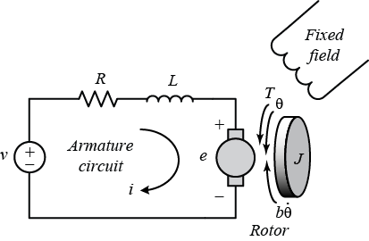
DC motor dynamics
V applied voltage, I is the current drawn
R resistance of coil and brush contact
L is the coil inductance
EMF is back emf of motor
Lets relate output speed of motor to the applied voltage!
R = Armature resistance (in ohms)
L = Armature inductance (in Henrys)
J = Moment of inertia for the motor rotor (kg.m2)
b = Motor viscous friction constant (in N.m.s)
K_{t} = Motor torque constant (in N.m/A)
K_{e} = Electromotive force constant (in V/rad/sec)

Slide 31
DC motor dynamics
Motor torque T_{m} is given by the current multiplied by the torque constant of the motor
Mechanical resisting torque T_{r} is given by inertia and viscous friction
Therefore equating the two terms gives torque equation
Rearranging torque equation

Slide 32
DC motor dynamics
Summing voltages around the circuit gives voltage equation

Slide 33
State space DC motor dynamics
Now writing
from
Now writing
from

Slide 34
State space DC motor dynamics
So we have the two equations
We can write these two equations in matrix form
If we want to observe the speed of the motor as the output y

Slide 35
State space DC motor dynamics
As we will later see the two equations describe the motor in state space form
By observation of standard state space form
We see that

Slide 36
ROCO218: Control Engineering Dr Ian Howard Lecture 2 Numerical solutions of 1st order differential equation

Slide 37
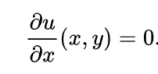
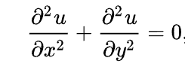
Differential equations
Ordinary differential equation (ODE)
contains one or more functions of one independent variable and its derivatives
For example
Partial differential equation
may compare more than one independent variable
contains unknown multivariable functions and their partial derivatives.
For example

Slide 38
Local linear approximation of gradient
y
Consider a function y=f(x)
When x=x₀ then y=y₀
y₁
Δy
As we increase the value of x by Δx
we reach a point where x₁=x_{o}+Δx
Similarly this increases y by Δy
reaching the value y₁=y_{o}+Δy
Thus
y_{o}
Δx
x
The gradient of the curve at (x_{o}, y_{o}) is the tangent to the curve at this point
x_{o}
x₁

Slide 39
Local linear approximation of gradient
y
In general the differential of a function is given by
y₁
Δy
y_{o}
Δx
Which is only strictly true in the limit where dx tends to zero
In our case
So the gradient at (x_{o}, y_{o}) can be approximated by
x_{o}
x₁
x

Slide 40
Local linear approximation of gradient
y
We can use the relationship to iteratively estimate y₁ from y_{o} since
y₁
Δy
y_{o}
Δx
Writing Δx as step size h
x_{o}
x₁
x
We can use this to give next estimate of y₁ if we know x_{o} and the gradient at (x_{o} y_{o} )

Slide 41
Euler’s method of integration
This is Euler’s method to solve a 1st order differential equation!
It uses a local linear approximation to the gradient
We can iteratively estimate the value of the function at the next step
Given the relationship
Where
t is time
y is the output value of the function
At initial time t_{o} the output is y_{o}
At future time t_{(n+1)} the output is y_{(n+1)}
h is the step size
Notice the simulation error will rise as the step size increases!

Slide 42
Remember: Voltages in an RC circuit
Adding up voltages
Ohms law
Current proportional to
rate of change of charge
Substitute I from
capacitor expression
Rearranged
This is a first order linear differential equation

Slide 43
Simulation of voltages in an RC circuit
Here we wish to compute the evolution of V_{c} with time. We know that
From the iterative relationship we derived previously
One of your lab assignments is to implement this simulation in Matlab!
Matlab also has more sophisticated numerical methods to solve differential equations- e.g. ode45

Slide 44
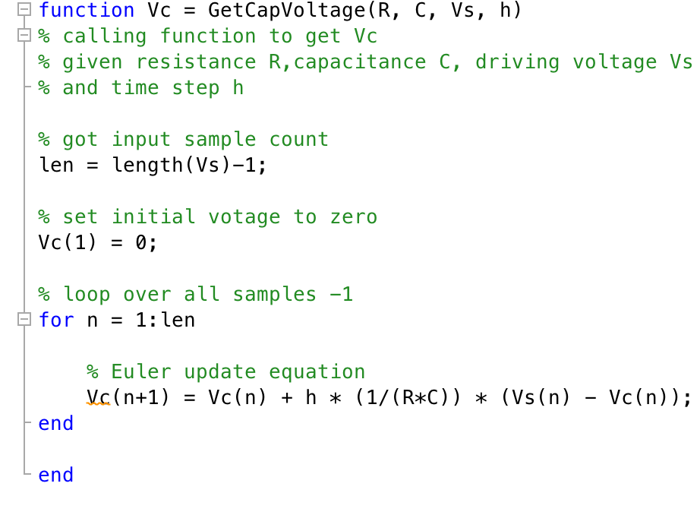
Implementing Euler integration in Matlab
We can write simple script using the update equation to estimate capacitor voltage is given by the equation

Slide 45
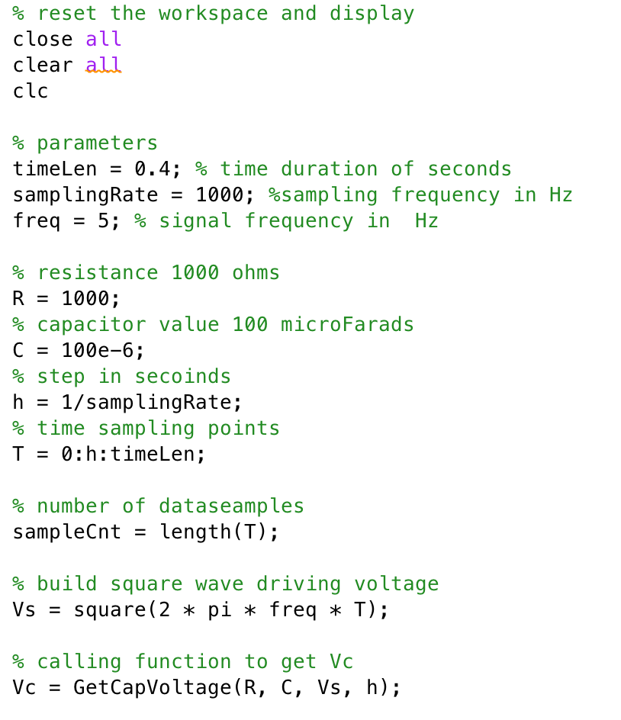
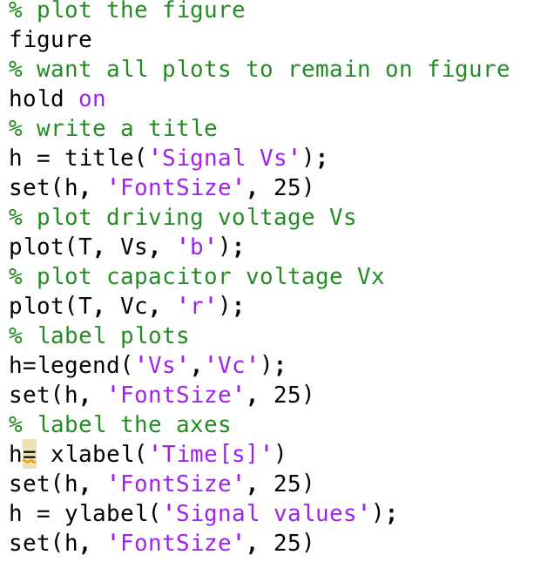
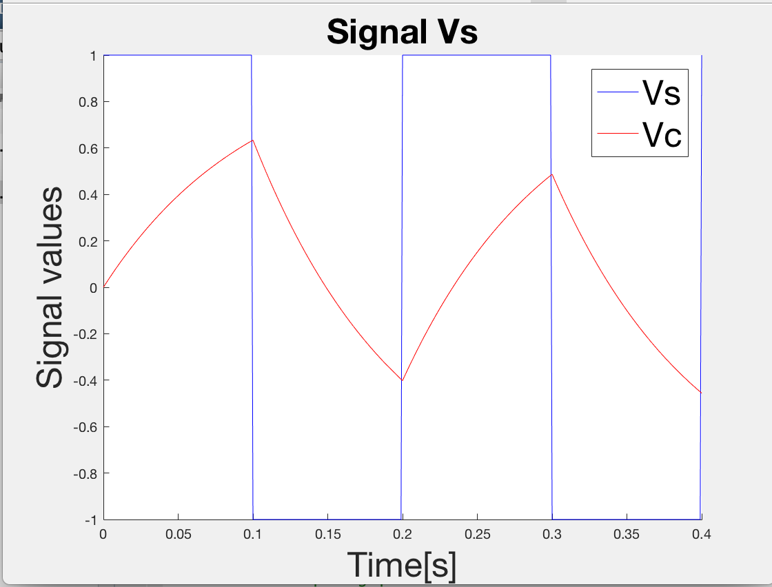
Implementing Euler integration in Matlab

Slide 46
Using ode45 to perform integration
help ode45
Solve non-stiff differential equations, medium order method.
[TOUT,YOUT] = ode45(ODEFUN,TSPAN,Y0)
with TSPAN = [T0 TFINAL] integrates the system of differential equations y' = f(t,y) from time T0 to TFINAL with initial conditions Y0.
ODEFUN is a function handle.
For a scalar T and a vector Y, ODEFUN(T,Y) must return a column vector corresponding to f(t,y).
Each row in the solution array YOUT corresponds to a time returned in the column vector TOUT.
To obtain solutions at specific times T0,T1,...,TFINAL (all increasing or all decreasing), use TSPAN = [T0 T1 ... TFINAL].

Slide 47
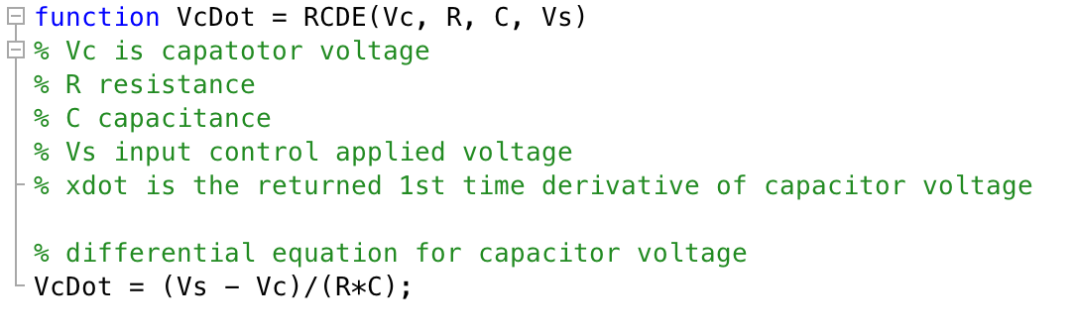
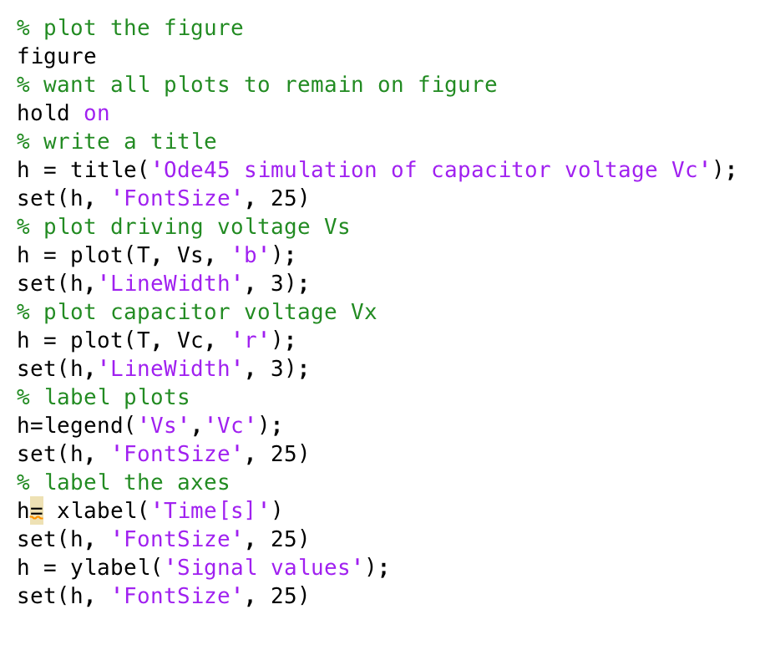
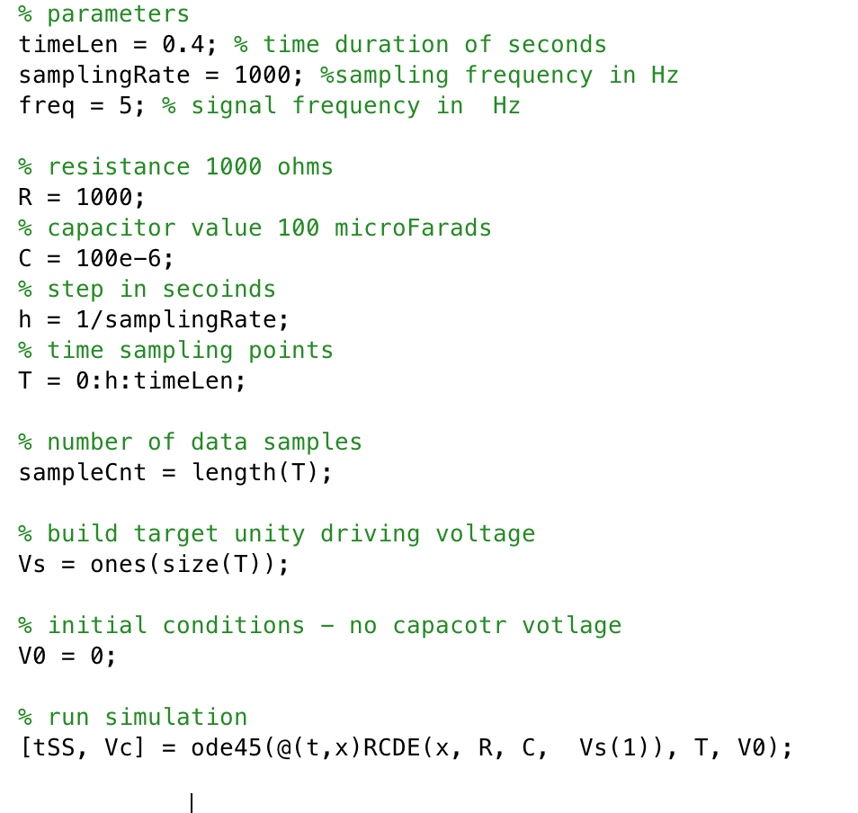
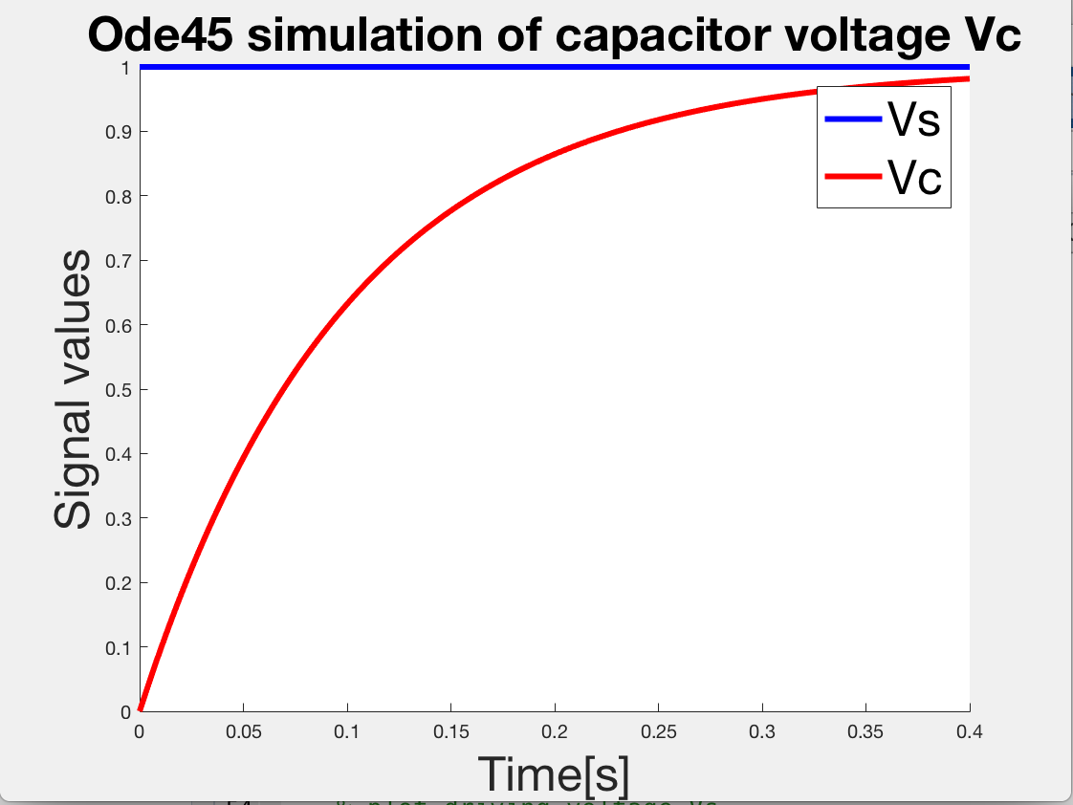
Using ode45 to perform integration

Slide 48
Interlude 10 minute break

Slide 49
ROCO218: Control Engineering Lecture 2 Introduction to Simulink

Slide 50
Simulink
Used to model, analyze and simulate dynamic systems using block diagrams.
Provides a graphical user interface for constructing block diagram of a system – therefore is easy to use.
Can be used for simulation of various systems:
Linear, nonlinear
Input signals can be arbitrarily generated:
Standard: sinusoidal, polynomial, square, impulse
Customized: from a function, look-up table
Output signals can be stored or demonstrated in different ways.
However modeling a system is not necessarily easy !

Slide 51
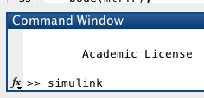
Launching Simulink
First launch Matlab
Then in the Matlab command window launch slimulink
Do this at the >> prompt by typing simulink
and press  Enter

Slide 52
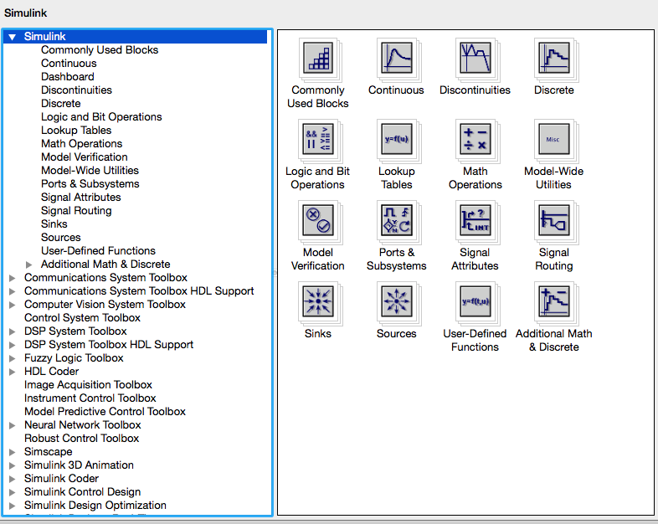
Simulink window

Slide 53
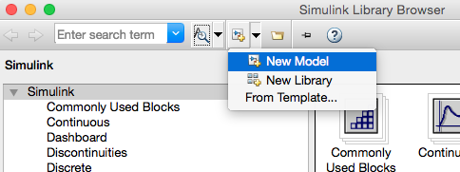
Create a new model
Next click the new-model icon in the upper left corner to start a new Simulink file

Slide 54
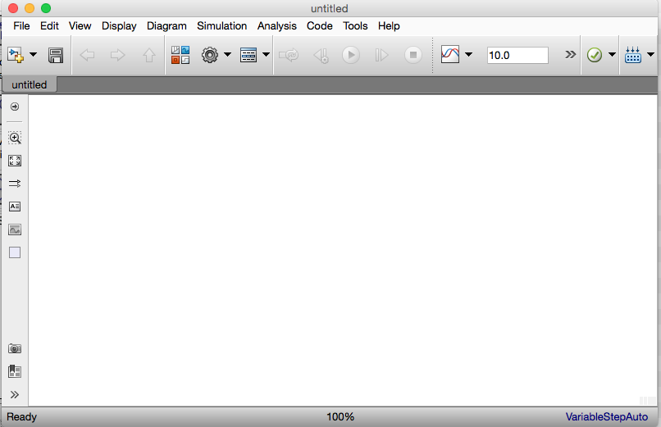
Your workspace
This opens a window

Slide 55
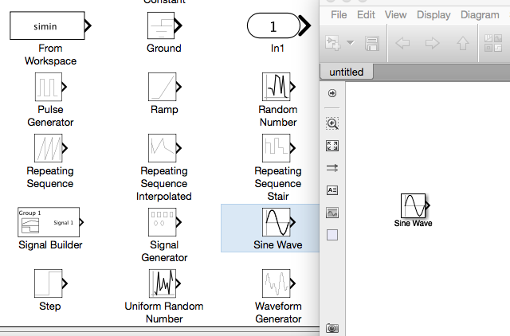
Add components
Drag selected components into workspace

Slide 56
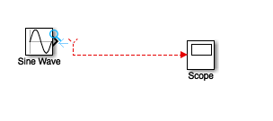
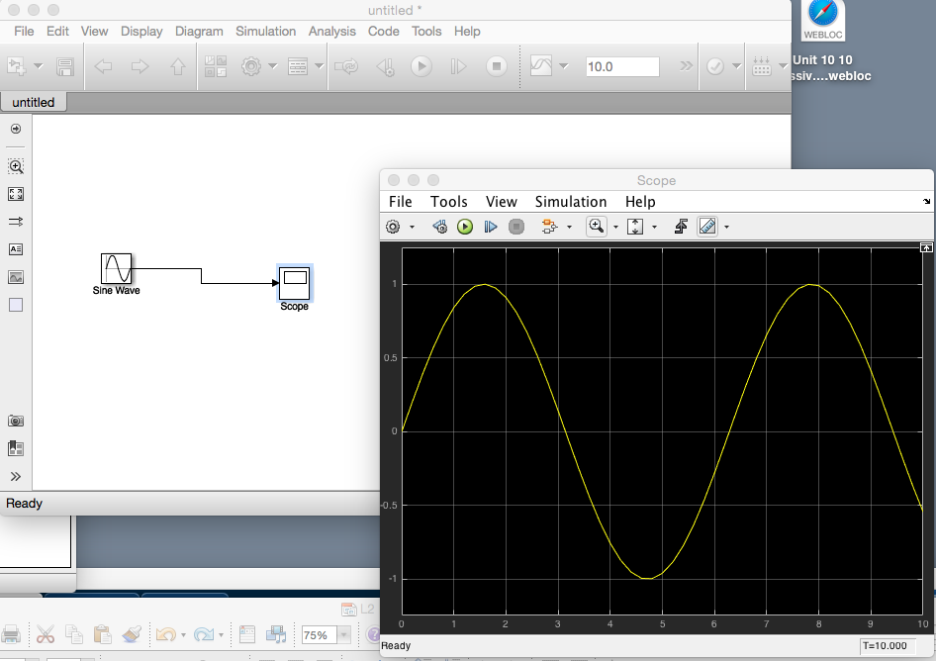
Connect components and run model
Connect components
Click run button
Click on scope
to open display

Slide 57
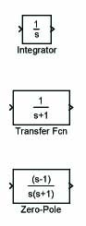
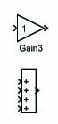
Available components blocks
Main components exhibit dynamics:
integrators,
transfer function
zero-pole description
Parameters can be set for various components
Also math components:
gain (amplifier) kx : x a scalar
addition (a+b+c)
product (abc)
number of i/o points and the sign of each are adjustable

Slide 58
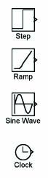
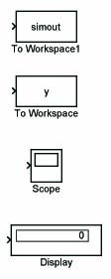
Many components blocks available
Sources: input signals
constant, step, ramp
pulse, sine wave, square wave
from data file
signal generator
a clock to record time
Sinks: for output display or storage
export to workspace; you can give a name
to the variable, such as u, y, x, etc.
scope
digital display

Slide 59
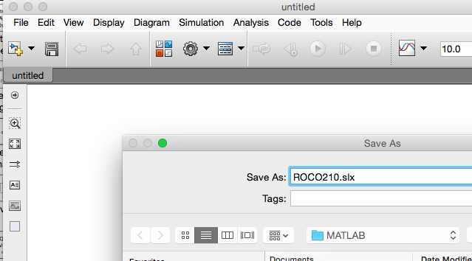
Save your model

Slide 60
ROCO218: Control Engineering Dr Ian Howard Lecture 1 Simulink 2nd order differential equation

Slide 61
Mass-spring-damper system
Build a Simulink model that solves the following differential equation
2nd-order mass-spring-damper system
zero initial conditions
input f(t) is a step with magnitude 3
parameters: m = 0.25, c = 0.5, k = 1

Slide 62
Create the simulation diagram
The simulation diagram for solving the ODE is created step by step.
After each step, elements are added to the Simulink model.

Slide 63
Create the simulation diagram
First, solve for the term with highest-order derivative
Make the left-hand side of this equation the output of a summing block
summing block

Slide 64
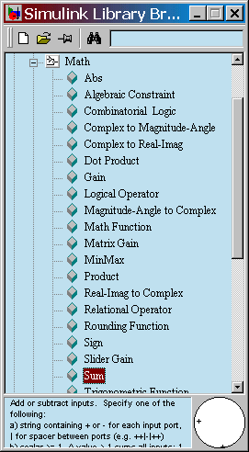
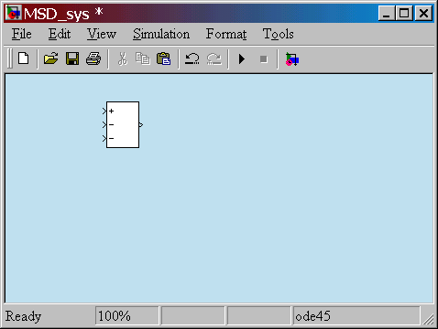

Create the simulation diagram
Drag a Sum block from the Math library
Double-click to change the block parameters to rectangular and + - -

Slide 65
Create the simulation diagram
Add a gain (multiplier) block to eliminate the coefficient and produce the highest-derivative alone
summing block

Slide 66



Create the simulation diagram
Drag a Gain block from the Math library
The gain is 4 since 1/m=4.
Double-click to change the block parameters.
Add a title.

Slide 67
Create the simulation diagram
Add integrators to obtain the desired output variable
summing block

Slide 68


Create the simulation diagram
Drag Integrator blocks from the Continuous library
ICs on the integrators are zero.
Add a scope from the Sinks library.
Connect output ports to input ports
Label the signals by double-clicking on the leader line

Slide 69
Create the simulation diagram
Connect to the integrated signals with gain blocks to create the terms on the right-hand side of the equation of motion
summing block
c
k

Slide 70



Create the simulation diagram
Drag new Gain blocks from the Math library
To flip the gain block, select it and choose Flip Block in the Format pull-down menu.
Double-click on gain blocks to set parameters
Connect from the gain block input backwards up to the branch point.
Re-title the gain blocks.
c=0.5
k=1.0

Slide 71
Complete the model
Bring all the signals and inputs to the summing block
Check signs on the summer
f(t)
input
+
-
x(t)
output
-
c
k

Slide 72



Drive with a step function
Double-click on Step block to set parameters. For a step input of magnitude 3, set Final value to 3

Slide 73
Final Simulink model

Slide 74

Run the simulation

